Slide 1
Military & Defense Applications

Slide 2

Defense-Ready Solutions
At Sensata Technologies, we are proud to support the mission-critical needs of the global defense industry. Our advanced portfolio of circuit protection, solid-state switching, contactors, motors, actuators, and RF Reed Relays are engineered to perform in the most demanding environments.
With decades of proven reliability, Sensata’s solutions are trusted across a wide range of military platforms, from armored vehicles and missile systems to naval vessels and aerospace applications. Our products meet rigorous military standards and are designed to ensure operational continuity, safety, and performance in the harshest conditions.
Explore the various product lines from Sensata’s brands.

Slide 3






Defense Applications
 | High Power Contactors | Pressure and Temperature Sensors | Position Sensors and Encoders | RF Reed Relays | Solid State Relays | Hydraulic Magnetic Circuit Breakers
Radars
MBTs
UAVs/UGVs & Control Stations
Radios, C4I, EW, SIGINT
Ships and Patrol boats
Infantry Vehicles
Aerospace Ground Equipment
Mobile Power - Gensets, Field Utilities

Slide 4
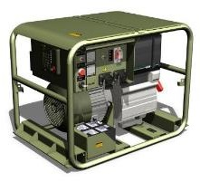
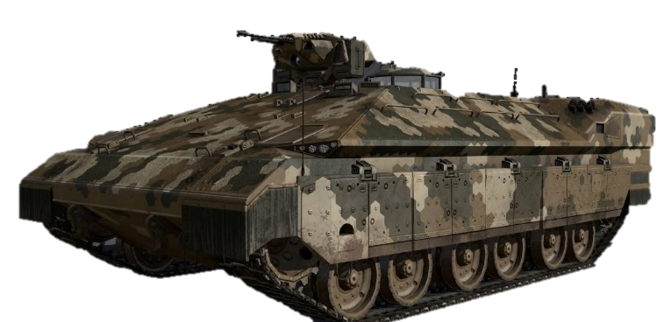
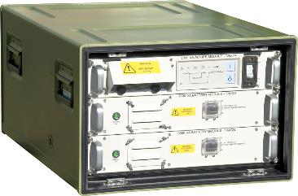
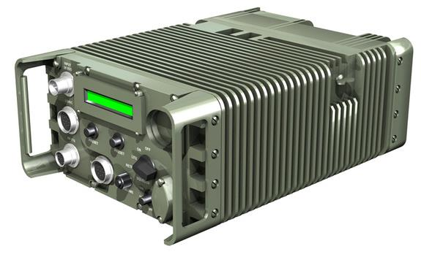
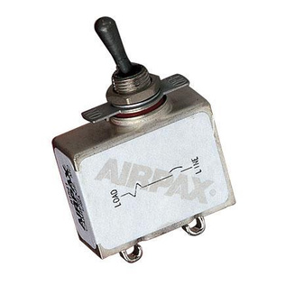
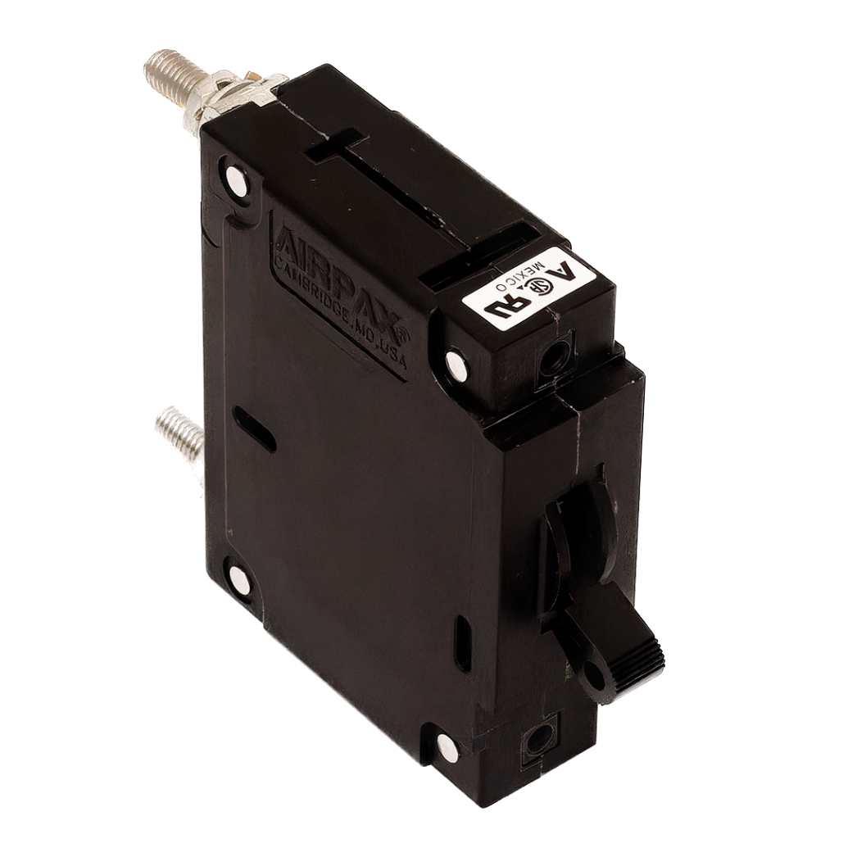

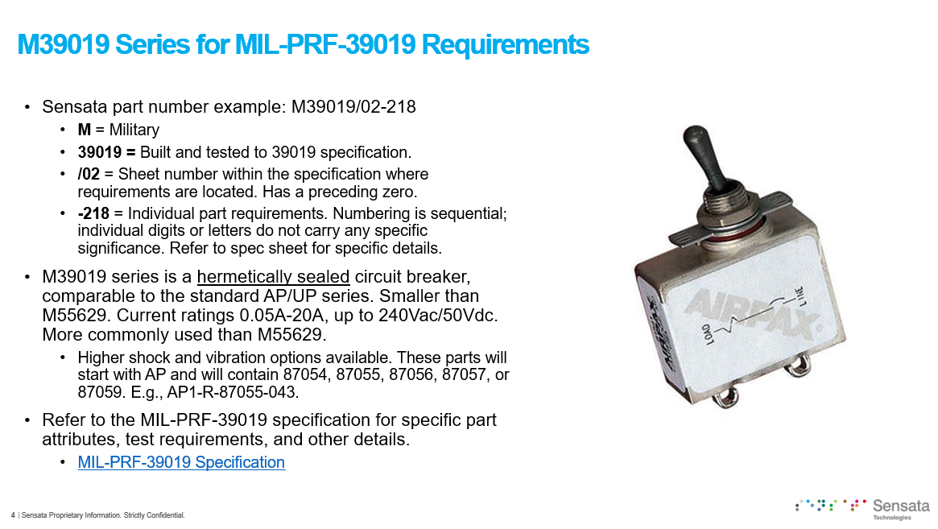
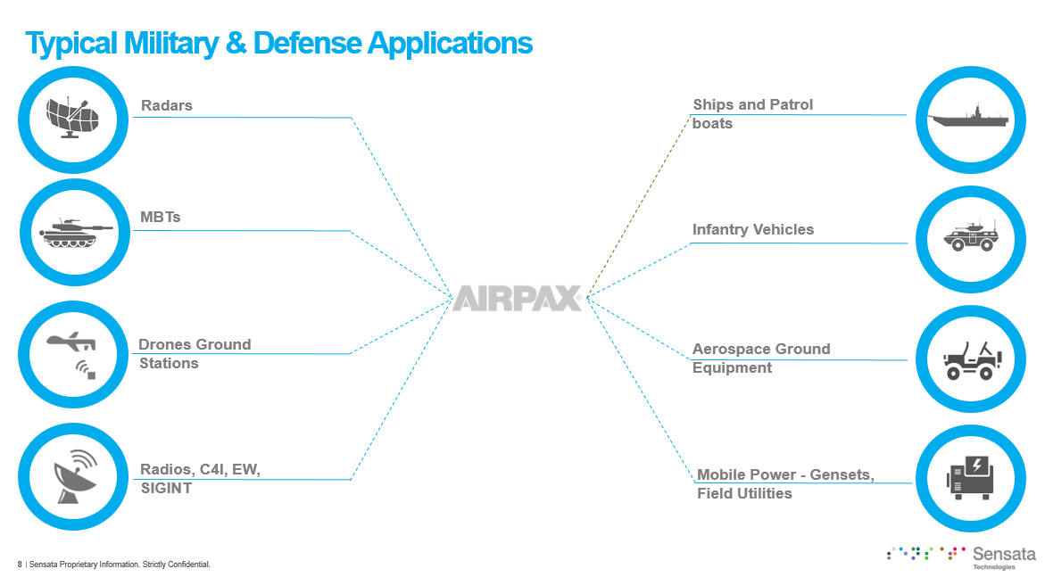
Military & Defense Market
Applications: Generators, power supplies, military vehicles, radios and other small/medium equipment, HVAC equipment
Market Drivers: Rising defense spending, geopolitical tension, advanced equipment demand
Focus Products: M55629 + M39019 for USA applications requiring QPL. AP, IUL/IEL, IUG for broader military applications
Competition: For QPL parts we are the only breaker manufacturer with approval. For commercial/standard parts for non-USA applications typically Carling/Littelfuse SM, A, B series
New Sales Materials to Help You Win: Training deck on Airpax for Military Applications now available in Showpad. Share with your distributors, local reps, present it to your customers
Strategy, Target Customers, Support Needed:
  Distribution promotion around the new deck. Share and review focus accounts for targeted outreach and selective trainings.
  50% of existing EU military NR is QPL parts where we have no competition; activity is strong in Europe for non-EU military applications

Slide 5
Product Lines

Slide 6
Hydraulic Magnetic Circuit Breakers

Slide 7
Airpax Hydraulic Magnetic Circuit Breakers
Features
0.05A to 100A+ with AC/DC options
Both hermetically & non-hermetically sealed
Trip-free, temperature-stable design
  Magnetic operation unaffected by ambient temperature
MIL-STD-202 tested
  Shock, vibration, salt spray, and moisture resistance
Multiple form factors: toggle, rocker, and panel-sealed options
UL, CSA, EN, and MIL certifications
Customizable delays & configurations
Military Application
Only QPL/QPD-listed manufacturer
Mission-critical reliability, with proven performance in radars, vehicles, drones, naval systems, and field utilities
Manufactured in secure, U.S.-aligned facilities
Used in both U.S. and international military platforms
COTS & custom solutions
  Supports both standard and specialized military needs

Slide 8

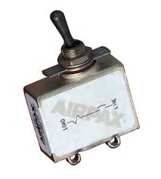




AP Series/M39019 (202 Series)
Hermetic Sealed Circuit Breaker
Product Features
Typical Applications
Up to 20A at 50Vdc, 15A at 120Vac, 7.5A at 240 Vac
Fully sealed
Inverse time delays
Trip-free features
Doesn’t change trip current over a wide temperature span
Available in either DC, 50/60Hz or 400Hz versions, and with various delays to match the protector to specific application requirements
Working temperature -40°C to +100°C
1-3 poles
MBTs
Drones Ground Stations
Aerospace Ground Equipment
Radios, C4I, EW, SIGNT
Infantry Vehicles
Datasheet

Slide 9
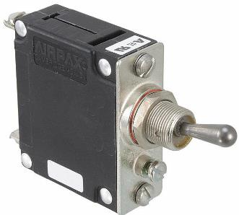



IALN/IULN/M55629 (214 Series)
Typical Applications
Panel Sealed Circuit Breaker
Product Features
MBTs
0.2A to 100A; up to 125Vdc or 277Vac per pole
Silicone rubber seal
1-3 poles
Sealed toggle
Drones Ground Stations
Aerospace Ground Equipment
Radios, C4I, EW, SIGNT
Infantry Vehicles
Radars
Mobile Power – Gensets, Field Utilities
Ships & Patrol Boats
Datasheet

Slide 10
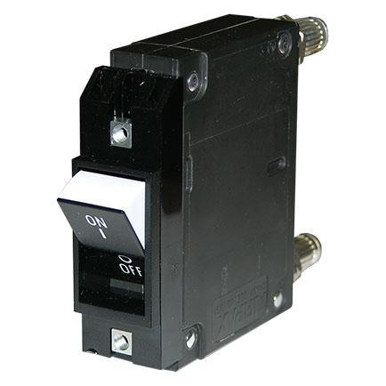
IAL/IUL/IEL/CEL/LEL (214 Series)
Flat Rocker Circuit Breaker
Product Features
Typical Applications
0.2 – 100A; up to 125Vdc or 277Vac per pole
BX style
Flat front rocker
Quick visual trip indication while guarding against accidental actuation
Full range of agency approvals
Meet or exceed all current performance specifications, including interrupting capacities up to 50,000 amps
1-3 poles
Not sealed
MBTs
Drones Ground Stations
Radars
Radios, C4I, EW, SIGNT
Infantry Vehicles
Datasheet

Slide 11
IAGN (217 Series)
Typical Applications
Panel Sealed Circuit Breaker
Product Features
MBTs
0.2A to 50A; up to 80Vdc or 250Vac per pole
Magnetic
Silicone rubber seal ensures panel seal integrity
Fit for harsh environments
1-3 poles
Sealed toggle
Drones Ground Stations
Aerospace Ground Equipment
Radios, C4I, EW, SIGNT
Infantry Vehicles
Radars
Mobile Power – Gensets, Field Utilities
Ships & Patrol Boats
Datasheet

Slide 12
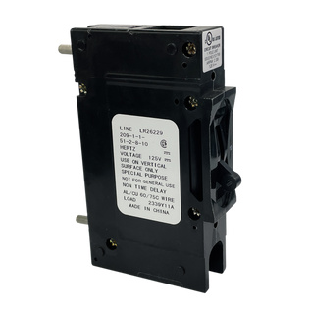
209 Series
High Current Circuit Breaker
Product Features
Typical Applications
0.1-100A; up to 160Vdc or 600Vac per pole
Not sealed
E-Frame
Combines power switching with accurate, reliable circuit protection in a compact single or multipole unit
Ideal for branch circuit applications such as EDP, air conditioners, panel boards, and lighting controls
Family of circuit breakers available in one through six pole assemblies with a variety of configurations and terminal styles
1-6 poles (parallel)
MBTs
Drones Ground Stations
Radios, C4I, EW, SIGNT
Infantry Vehicles
Radars
Mobile Power – Gensets, Field Utilities
Ships & Patrol Boats
Datasheet

Slide 13
Military & Defense Applications

Slide 14
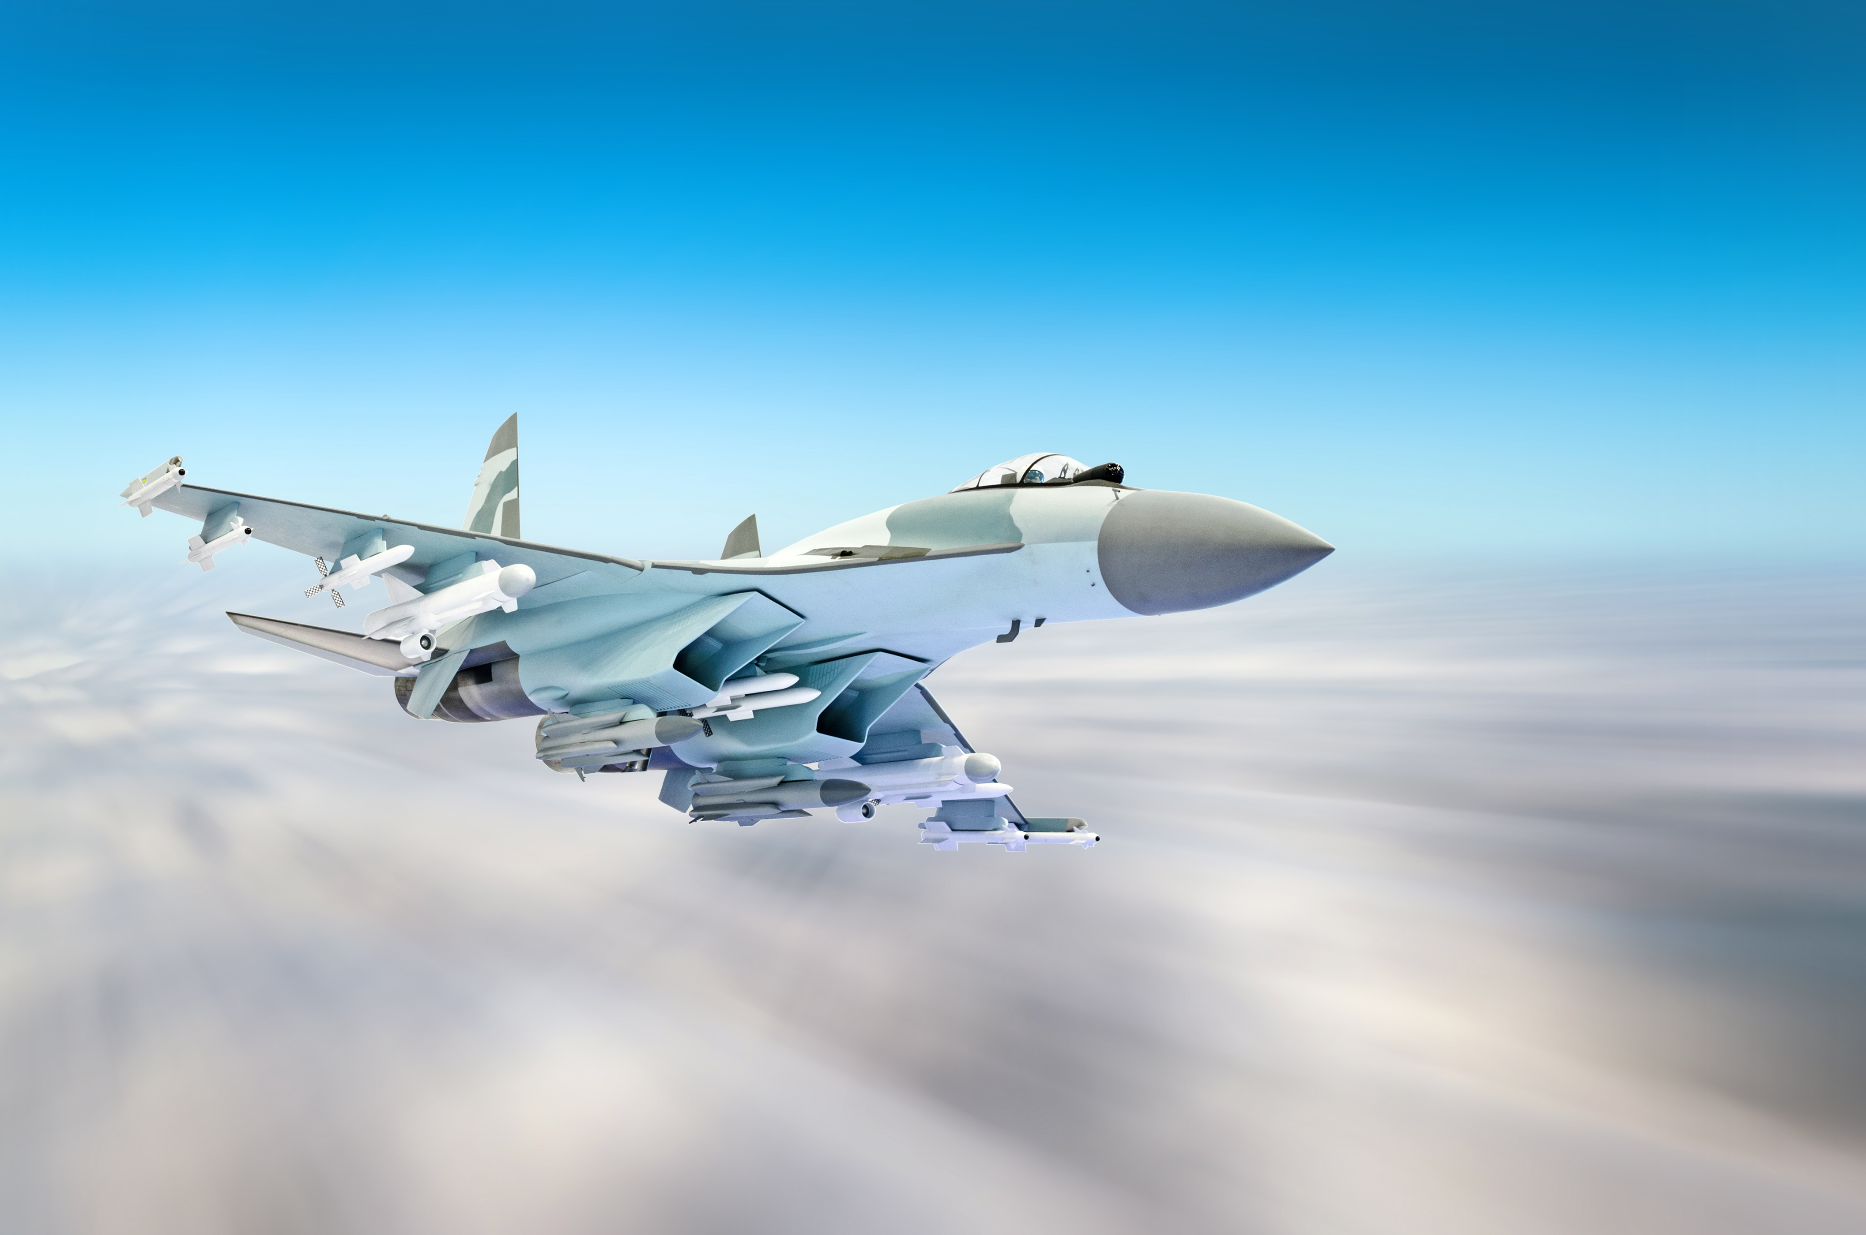
Cross-Product Applications
Sensata’s various product lines are built to perform cohesively as a unit.
In the following section, we explore how our diverse portfolio of products is deployed across key military domains, including communications, aerospace, vehicles, naval systems, radar, and power infrastructure. Each application highlights the critical role our solutions play in enhancing reliability, safety, and mission effectiveness across modern defense platforms.

Slide 15
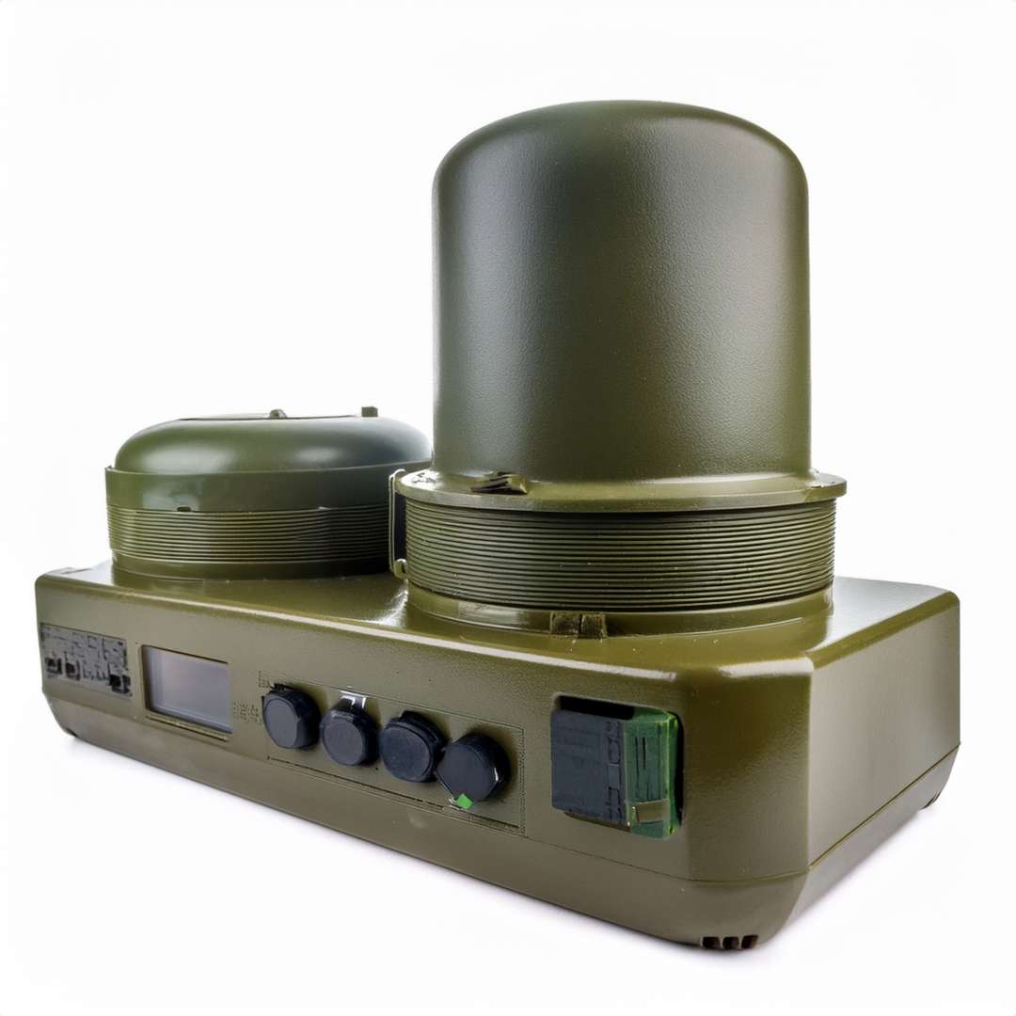
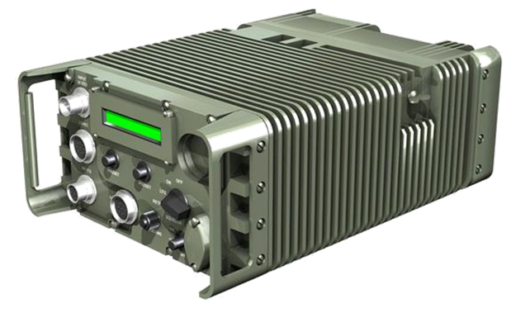
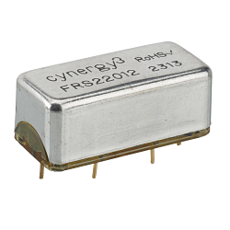
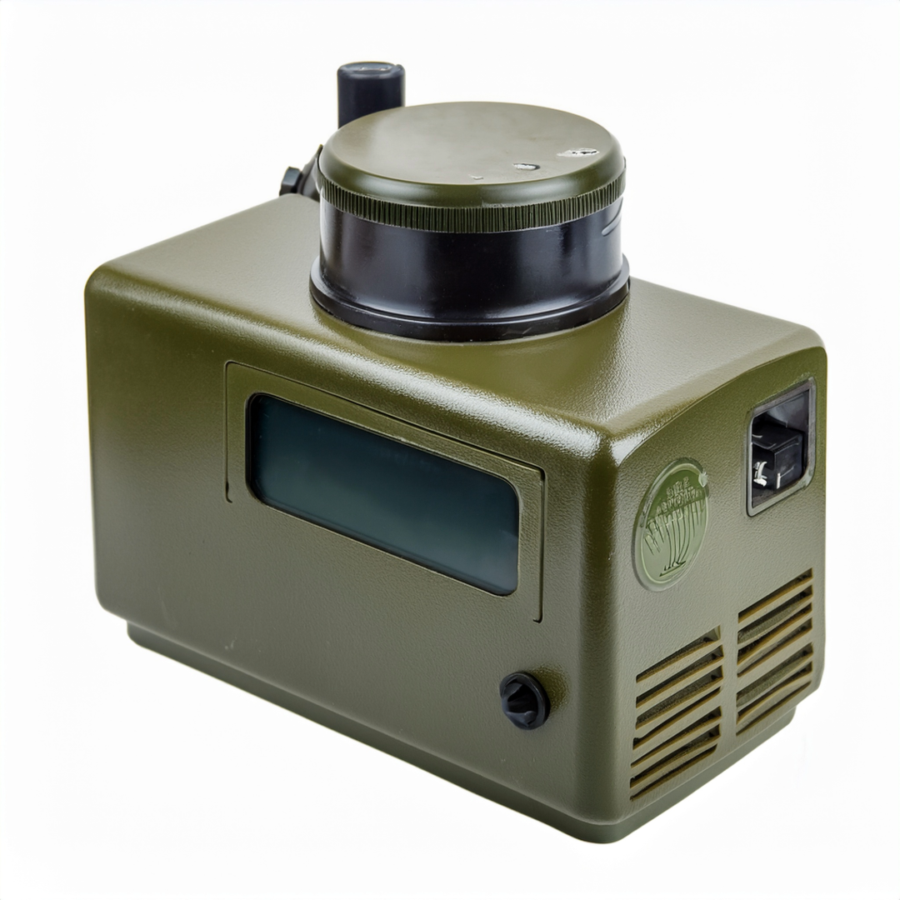
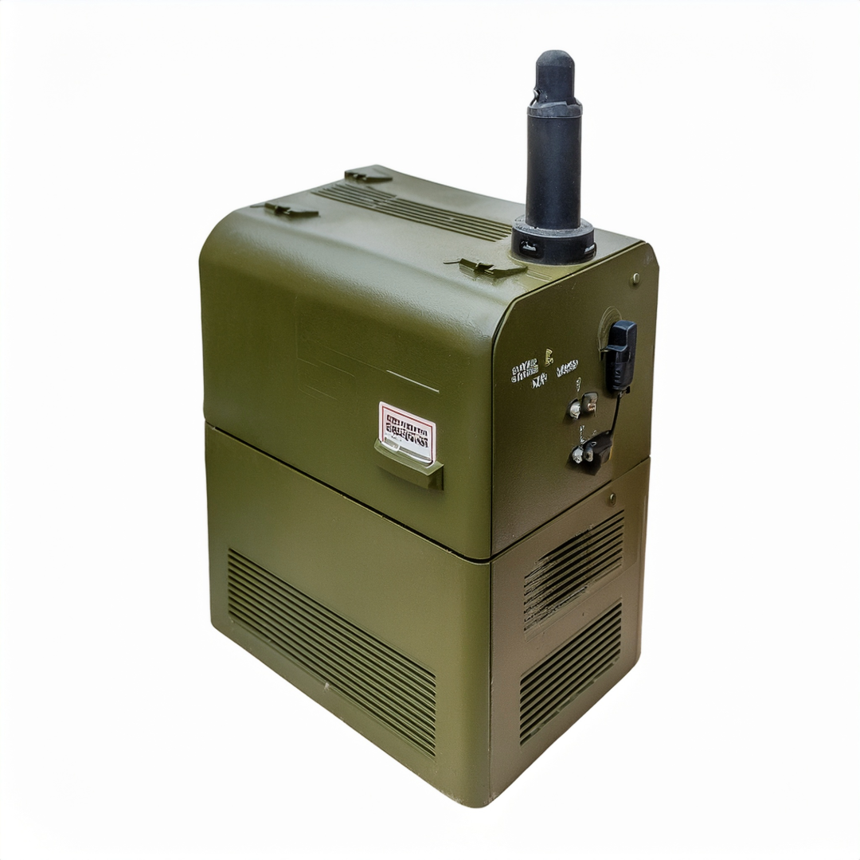
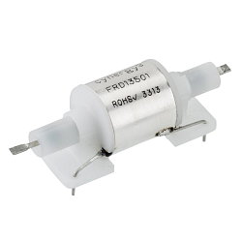
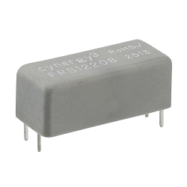
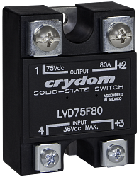
Communications
ATU, Radios, C4I, EW, SIGINT, Battery Protection on Communication Equipment, Drones Ground Stations
Typical Products
IALN/IULN/M55629 (214 Series)
209 Series
IAL/IUL/IEL/CEL/LEL (214 Series)
FRS22012
IAGN (217 Series)
FRD135xx
AP Series/M39019 (202 Series)
FRS122xx
LVD75B40/LVD75B100​

Slide 16

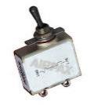
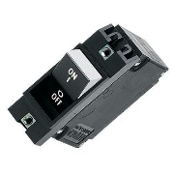
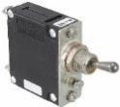
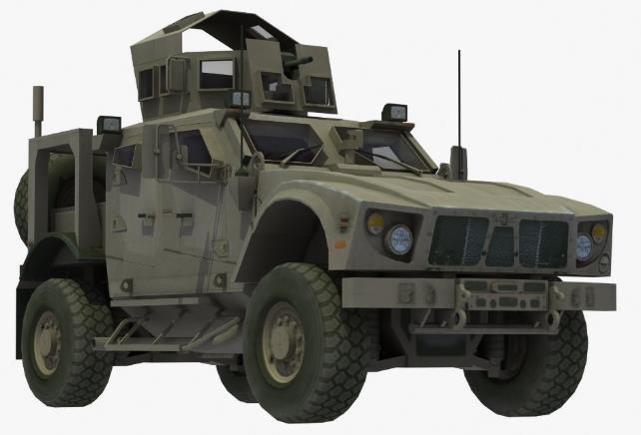
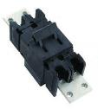
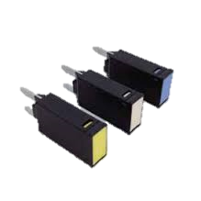
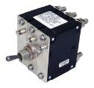
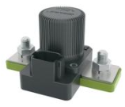
Armored Vehicles and MBTs
ATU, Radios, C4I, EW, SIGINT, Battery Protection on Communication Equipment, Drones Ground Stations
Typical Products
AP, M39019/ 0.05-20A
IAG, IUG, IEL, LEJ / up to 200A
IAGN, M55629 / 0.05-50A
JAE (2 poles) / up to 500A
IALN, IULN, M55629 / 0.05-100A
Mini 100/ up to 25A
IALNHPK / 0.05-300A
IALNHPK / up to 400A
MXxx Series / 48V, 150-1000A

Slide 17
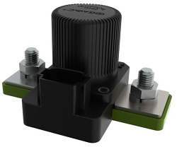
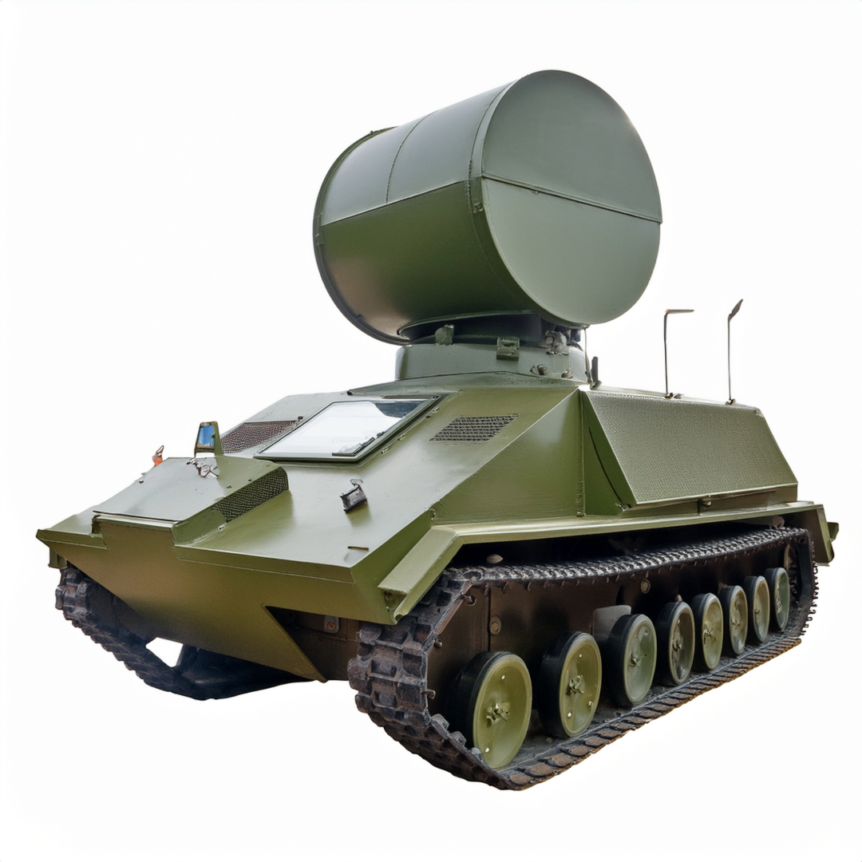
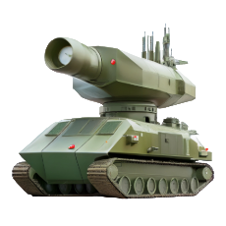
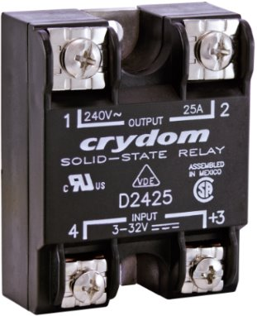
Missile Systems
Surface-to-Air Missile Platform, Missile Target Acquisition, OPIR Missile Warning System, Multi-Spectral Targeting System
Typical Products
MX Series
D4876
M55629 Series
IUG Series

Slide 18
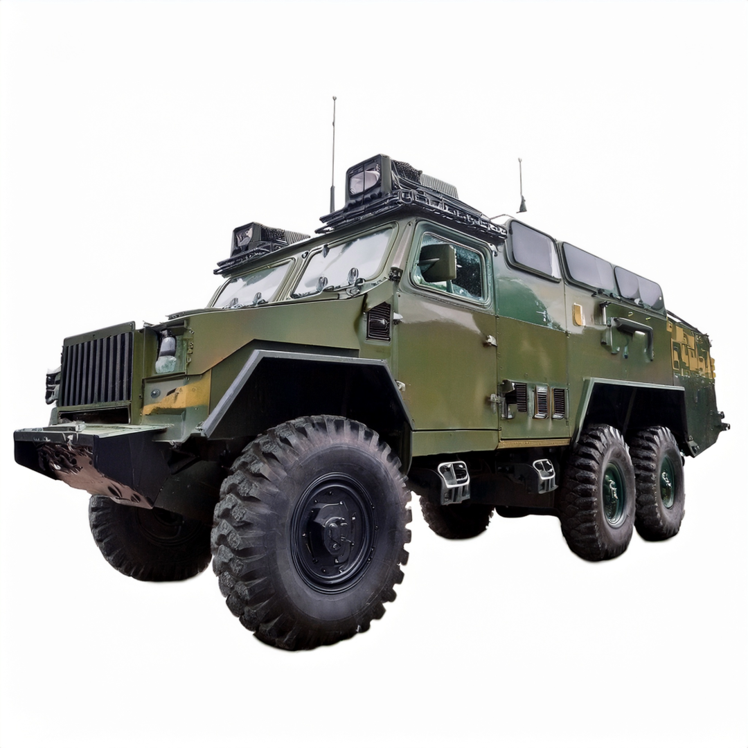
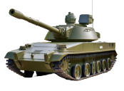
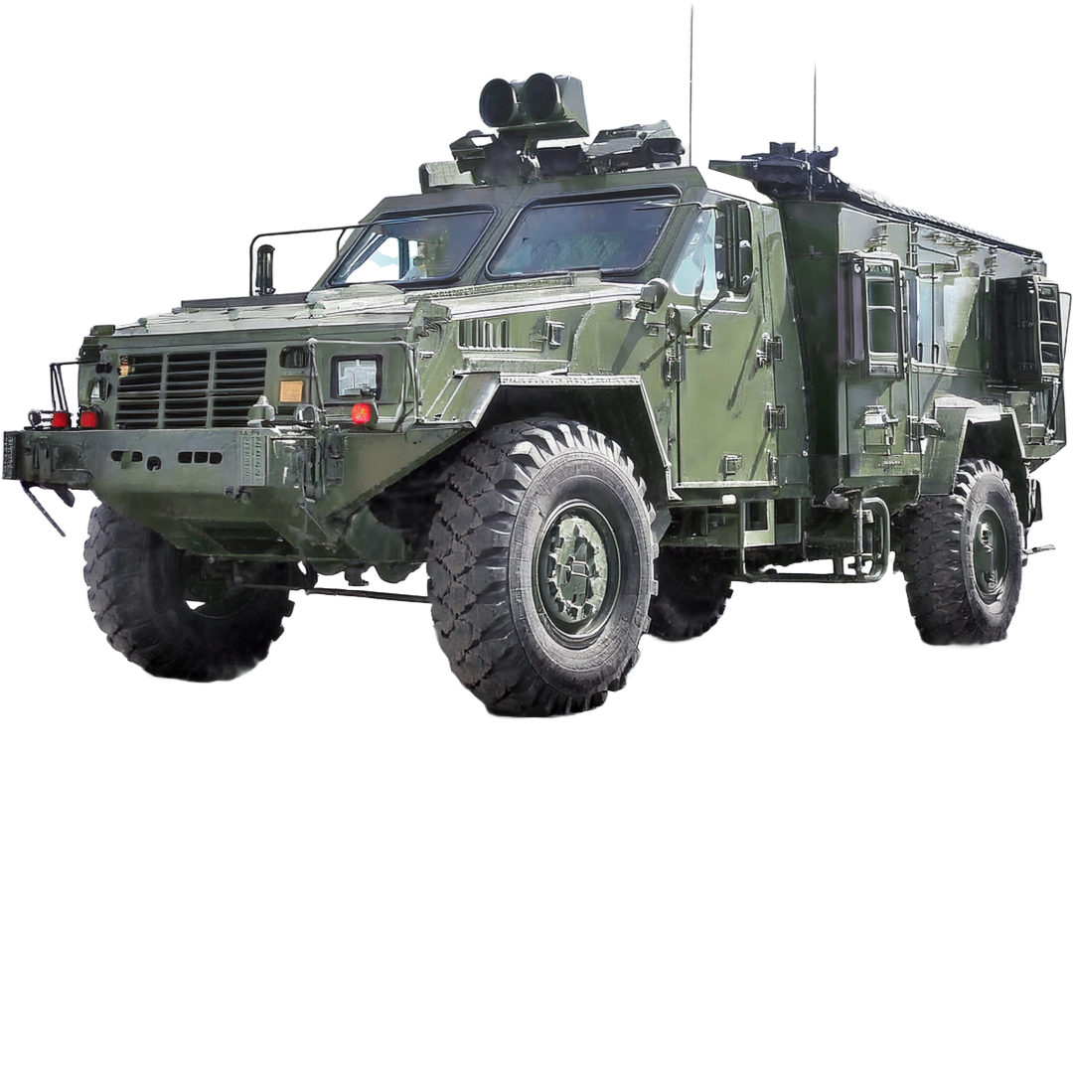
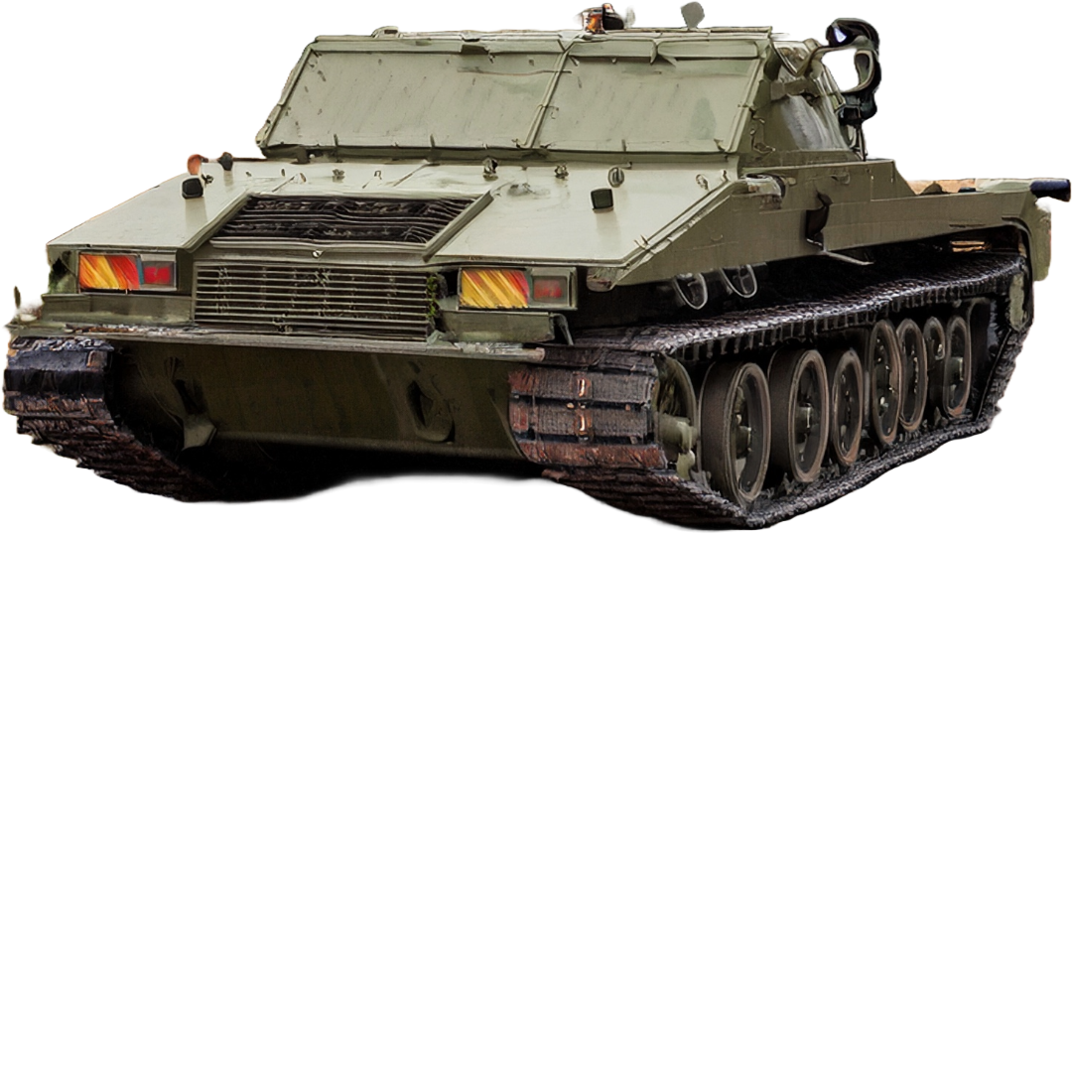
Vehicles
MBTs, Infantry Vehicles
Typical Products
209 Series
IALN/IULN/M55629 (214 Series)
AP Series/M39019 (202 Series)
IAL/IUL/IEL/CEL/LEL (214 Series)
IAGN (217 Series)
MX Series

Slide 19
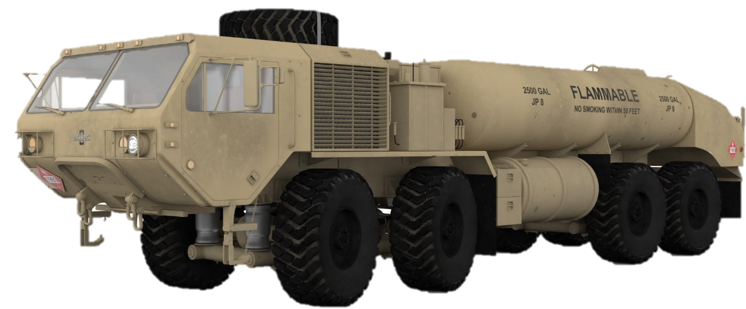
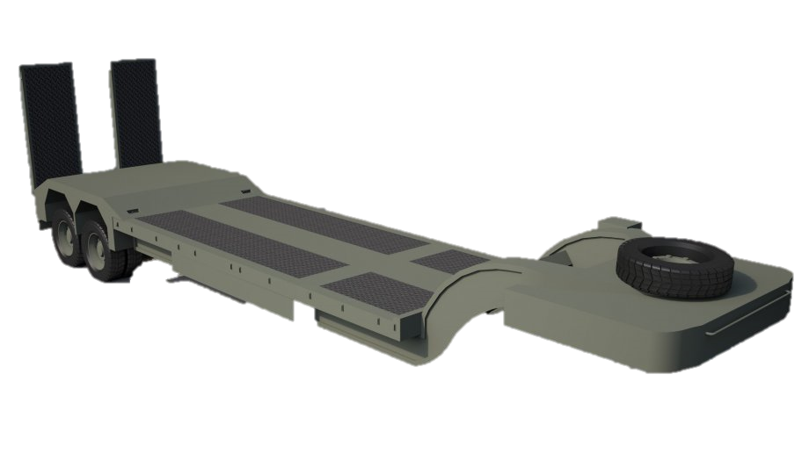
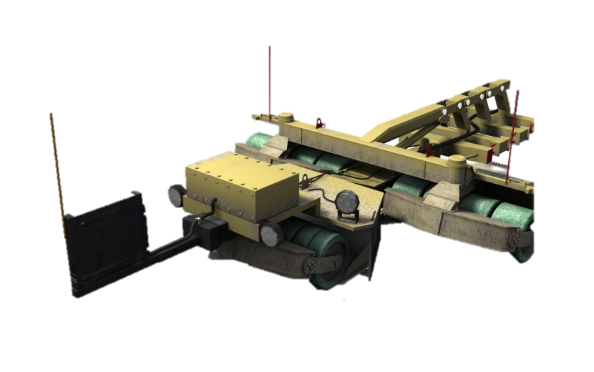
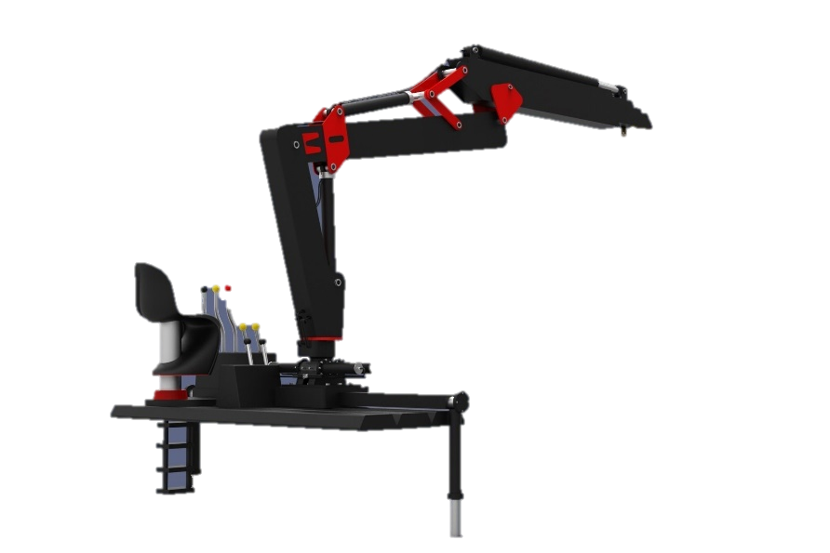
Military trucks, special trailers, cranes & accessories
Typical Products
Mobility, load‑handling, and mission‑support solutions for military operations
AP, M39019/ 0.05-20A
IAGN, M55629 / 0.05-50A
IAG, IUG, IEL, LEJ / up to 200A
IALN, IULN, M55629 / 0.05-100A
JAE (2 poles) / up to 500A
Mini 100/ up to 25A
IALNHPK / 0.05-300A
IALNHPK / up to 400A
MXxx Series / 48V, 150-1000A

Slide 20
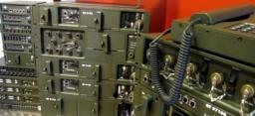

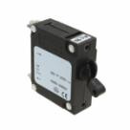
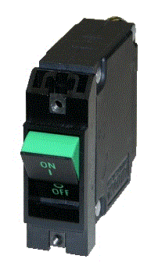
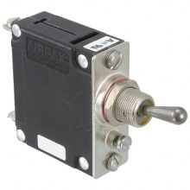
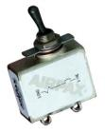
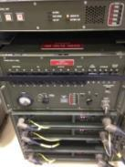
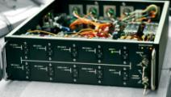
Power Distribution Units and Power Supplies
PDU and power supplied are used in military for a very broad range of scopes in military applications both in AC and DC:
Mobile and fixed radars
Mobile command posts (C4ISR)
Tactical communication systems
Power entry panels
In this applications can be found both ACCBs and Hy-mag CB

Slide 21
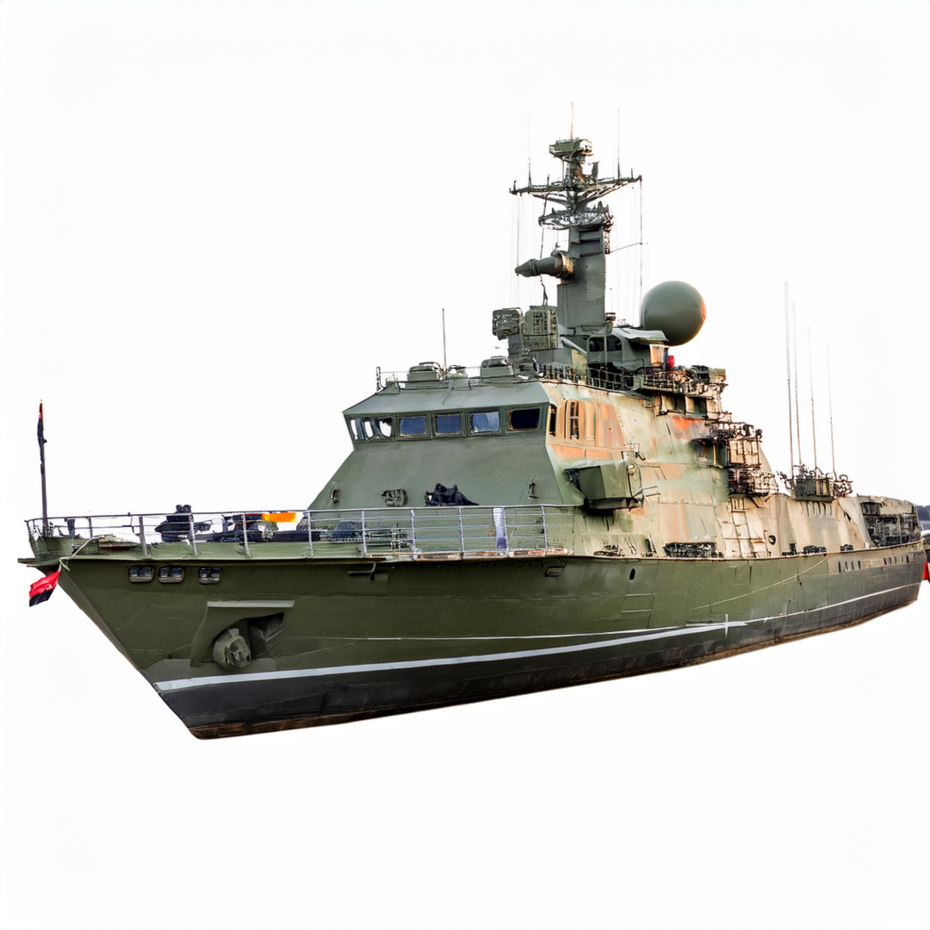
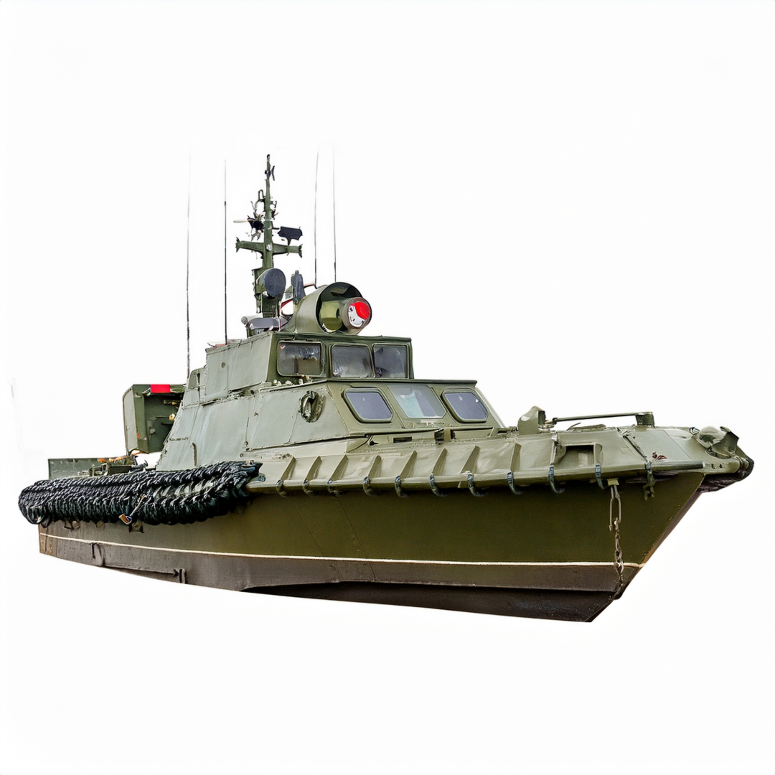
Naval
Ships & Patrol Boats
Typical Products
209 Series
LVD75B40/LVD5B100
MX Series
IALN/IULN/M55629 (214 Series)
IAGN (217 Series)

Slide 22



Radar
Radar Target Acquisition, Target Acquisition Fast Steering Mirrors
Typical Products
IALN/IULN/M55629 (214 Series)
209 Series
IAGN (217 Series)
IAL/IUL/IEL/CEL/LEL (214 Series)
CMX60D10

Slide 23



Ground and Naval Radars
Detection and tracking for land and maritime operations
Typical Products
AP, M39019/ 0.05-20A
IAG, IUG, IEL, LEJ / up to 200A
IAGN, M55629 / 0.05-50A
JAE (2 poles) / up to 500A
IALN, IULN, M55629 / 0.05-100A
IAL, LEL, CEL, IAG IUG / up to 400A
IALNHPK / 0.05-300A
MXxx Series / 48V, 150-1000A

Slide 24


Power
Mobile Power – Gensets, Field Utilities
Typical Products
Typical Products
IALN/IULN/M55629 (214 Series)
MX Series
IAGN (217 Series)
209 Series

Slide 25



Military Gensets & HVAC
Military gensets and HVAC systems support deployed electronics, battery charging, and shelter operations in harsh environments. Both applications must meet strict MIL specifications and require reliable protection and monitoring.
These systems are commonly equipped with Hy‑Mag circuit breakers and ACCBs, along with thermostats for temperature control, available in multiple MIL‑spec variants across the KISSOx and Airpax ranges. Pressure sensors or pressure switches from Sensata should also be considered for monitoring airflow, refrigerant, oil, or fuel pressure.

Slide 26
Thank You

